Slide 1
Properties and Propagation of EM Waves
Hari Shankar Gangwar
Email: hari5918phy@gmail.com

Slide 2
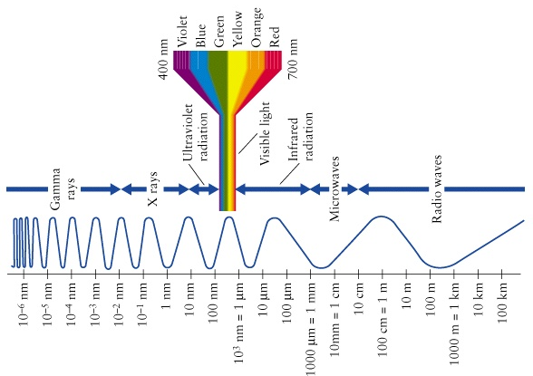
Electromagnetic Spectrum
Wavelength

Slide 3
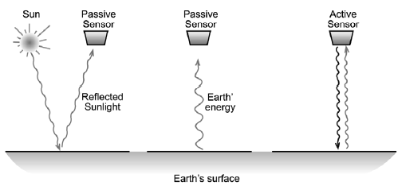
Role of Electromagnetic Radiation (EMR)
Remote Sensing relies on the measurement of Electromagnetic (EM) energy.
The most important source of EM energy is the sun. Some sensors detect energy emitted by the Earth itself or provide their own energy.
EMR has dual nature
1) Wave:
Considers EM energy as a harmonic, sinusoidal wave
Reflection, Refraction, Interference, Diffraction, Polarisation etc.
2) Particle:
Considers EMR as consisting of many discrete units i.e. photon, quanta etc.
Photoelectric Effect, Compton effect etc.
The two descriptions are not really contradictory.
The energy is emitted as photons, but its statistical distribution over time is described by a wave.

Slide 4
Importance of Understanding EM Wave Properties
Allow qualitative and quantitative description of EM Waves
Qualitative
Understand how microwave are created
How they are measured
How they interact with other media or discrete objects
Quantitative
Quantify physical processes (e.g., scattering) in terms of measurable parameters (e.g. frequency, polarization, directions, …

Slide 5
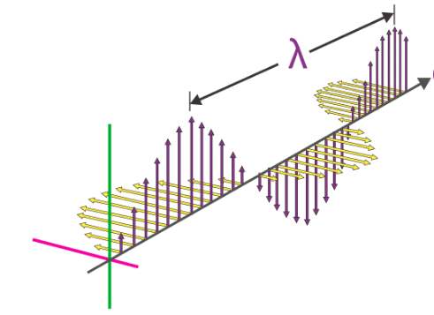
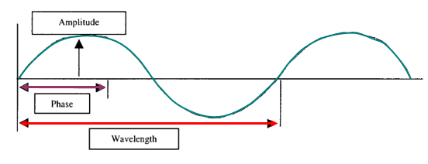
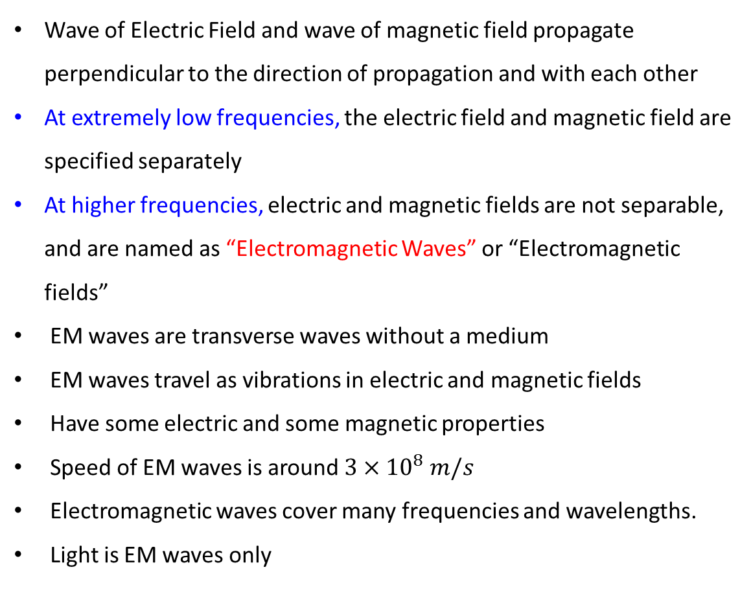
Key points of EM Waves
Wave of Electric Field and wave of magnetic field propagate perpendicular to the direction of propagation and with each other
At extremely low frequencies, the electric field and magnetic field are specified separately
At higher frequencies, electric and magnetic fields are not separable, and are named as “Electromagnetic Waves” or “Electromagnetic fields”
EM waves are transverse waves without a medium
EM waves travel as vibrations in electric and magnetic fields
Have some electric and some magnetic properties
Speed of EM waves is around $3×{10}^{8} m/s$
Electromagnetic waves cover many frequencies and wavelengths.
Light is EM waves only

Slide 6
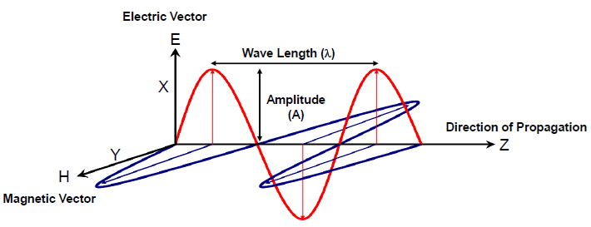
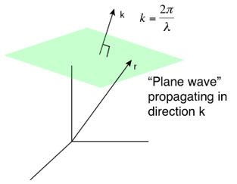

Wave Properties of EMR
EM waves are produced by motion of electric charge components and consists of
Electric Field (E) Vector
Magnetic Field (B) Vector
Both these fields travel at the speed of light
When travelling in a homogeneous, isotropic medium the electric and magnetic fields are at right angles to each other and are perpendicular to the direction of propagation.
Radar waves, like light waves are EM energy that propagates
Phase
Frequency
$$E(x,y,z,t)=E_{0}e^{jφ(x,y,z,t)}=E_{o}e^{j(ωt−\vec{k}.\vec{r})}$$

Slide 7
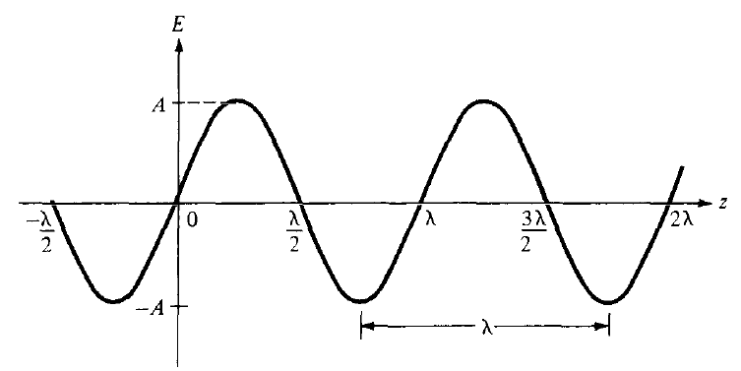
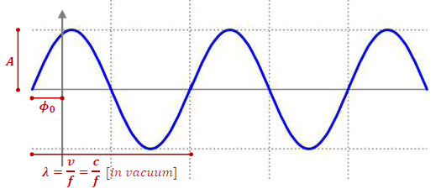
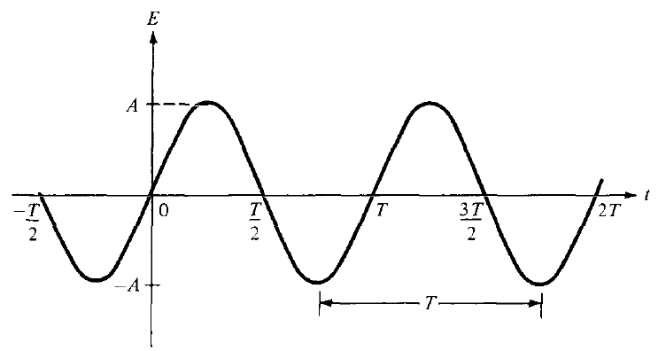


Wave Description of EM Signals
Simplest way of describing a wave: Harmonic waves (sine or cosine waves)
Typically we use three parameters to describe harmonic waves
$$ψ\left(t\right)=A.sin⁡(2πft+ϕ_{0})$$
$$ψ\left(r,t\right)=A.exp⁡(k.r+2πft+ϕ_{0})$$

Slide 8
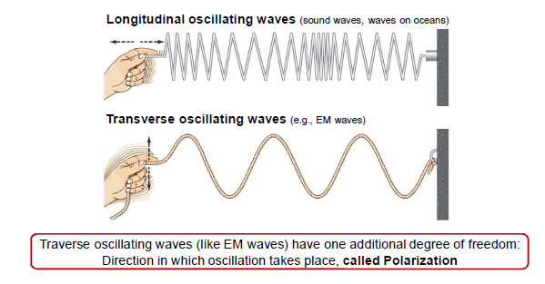
Transverse and Longitudinal Oscillation/Vibration

Slide 9
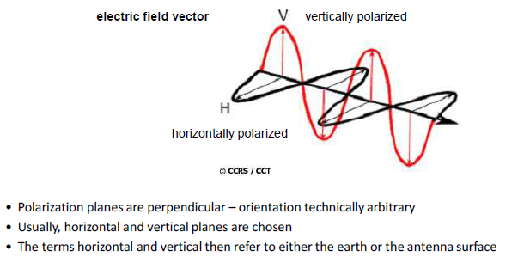
Polarization States of a coherent Plane Wave
Electric Field Vector
Vertically polarized
Horizontally polarized
Polarization planes are perpendicular – orientation technically arbitrary
Usually, horizontal and vertical planes are chosen
The terms horizontal and vertical then refer to either the earth or the antenna surface

Slide 10
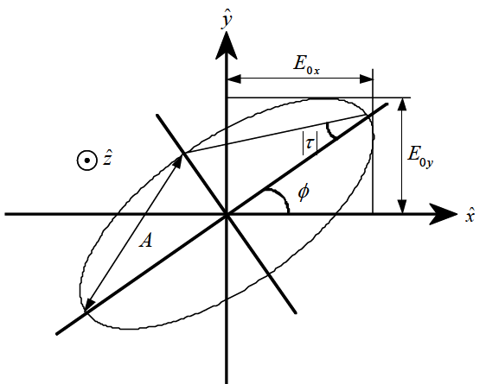
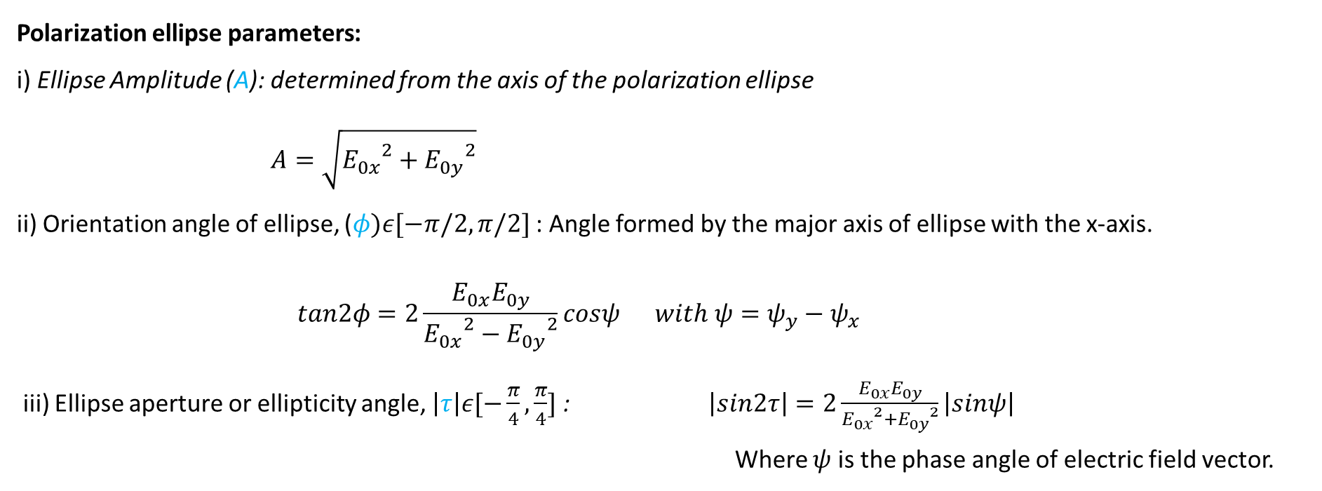
Polarization Ellipse
Parametric equation determines temporal wave trajectory
$${\left(\frac{\left.E_{x}(z_{0},t\right)}{E_{0x}}\right)}^{2}−2\frac{E_{x}\left(z_{0},t\right)E_{y}\left(z_{0},t\right)}{E_{ox}E_{oy}}\cos\left(ψ_{y}−ψ_{x}\right)+{\left(\frac{E_{y}\left(z_{0},t\right)}{E_{0y}}\right)}^{2}=\sin\left(ψ_{y}−ψ_{x}\right)$$
Polarization ellipse parameters:
i) Ellipse Amplitude (A): determined from the axis of the polarization ellipse
$A=\sqrt{{E_{0x}}^{2}+{E_{0y}}^{2}}$
ii) Orientation angle of ellipse, ($φ)ε[−π/2,π/2]$ : Angle formed by the major axis of ellipse with the x-axis.
$$tan2φ=2\frac{E_{0x}E_{0y}}{{E_{0x}}^{2}−{E_{0y}}^{2}}cosψ with ψ=ψ_{y}−ψ_{x}$$
iii) Ellipse aperture or ellipticity angle, $\left|τ\right|ε[−\frac{π}{4},\frac{π}{4}]$ : $\left|sin2τ\right|=2\frac{E_{0x}E_{0y}}{{E_{0x}}^{2}+{E_{0y}}^{2}}\left|sinψ\right|$
Where $ψ$ is the phase angle of electric field vector.

Slide 11
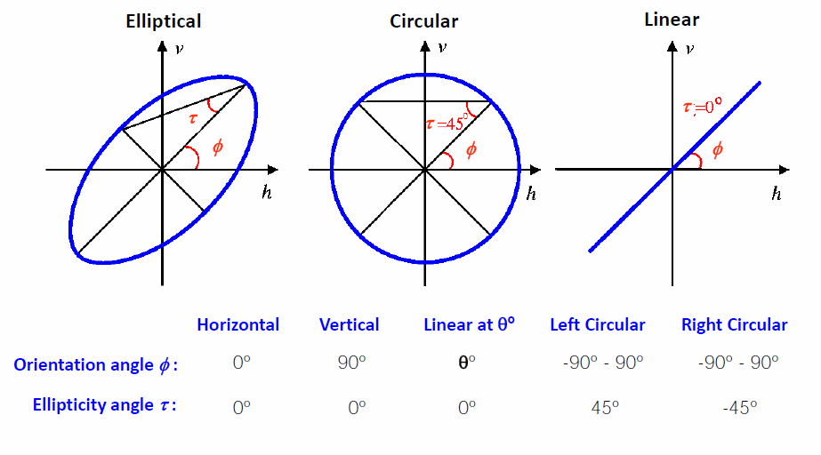
Canonical States of Polarization Ellipse

Slide 12
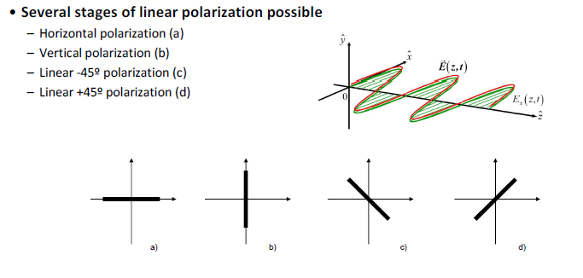
Linearly Polarized Signals
Several stages of linear polarization possible
Horizontal polarization (a)
Vertical polarization (b)
Linear -45 deg. Polarization (c)
Linear +45 deg. Polarization (d)

Slide 13
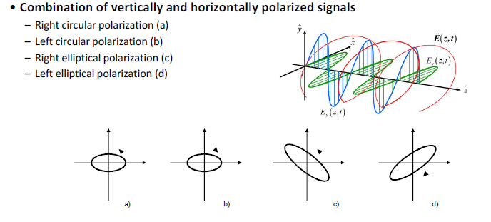
Circular and Elliptical Polarization
Combination of vertically and horizontally polarized signals
Right circular polarization (a)
Left circular polarization (b)
Right elliptical polarization (c)
Left elliptical polarization (d)

Slide 14
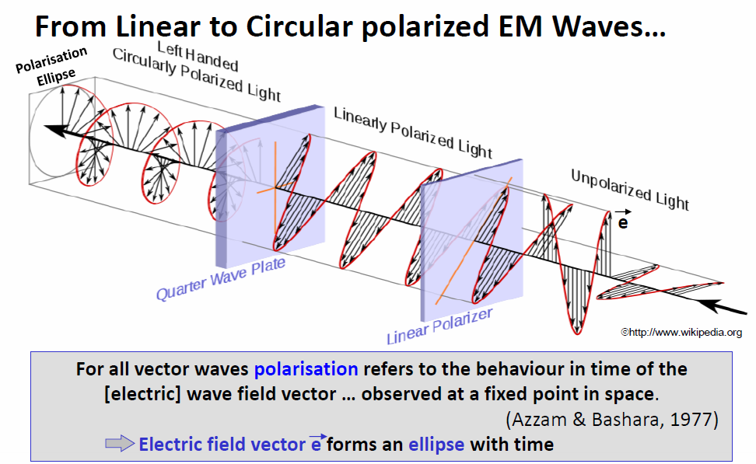
From Linear to Circular Polarized EM Waves…

Slide 15
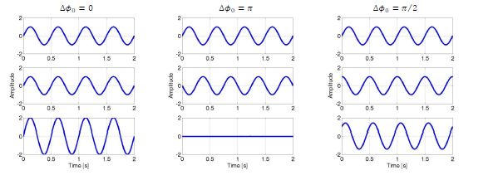
Combination of Waves
Superposition of waves called interference (e.g. two waves: ${ψ=ψ}_{1}+ψ_{2})$
As $ψ_{1}and ψ_{2}$ can have different amplitude, frequency, and phase, the shape of $ψ$ is not straightforward
Examples: A and f of waves kept the same; $φ_{0}$ can vary

Slide 16
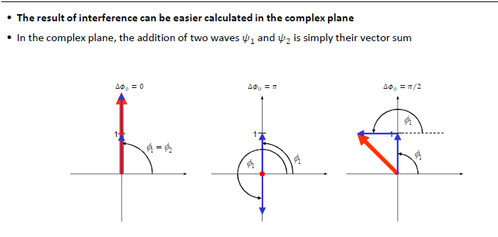
Combination of Waves
The result of interference can be easily calculated in the complex plane
In the complex plane, the addition of two waves $ψ_{1}and ψ_{2}$ is simply their vector sum

Slide 17
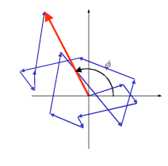
Interference and Coherence
Waves with phase difference that remain constant over time are said to be coherent
Coherent waves – combined wave vector is stationary
If coherence is low, interference effects are less predictable
Coherence can be seen as measure of predictability
Usually, the coherence is similarity between the waves over
finite interval of time or space

Slide 18
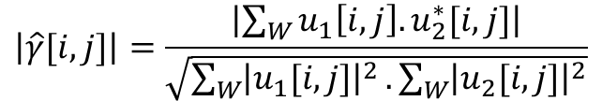
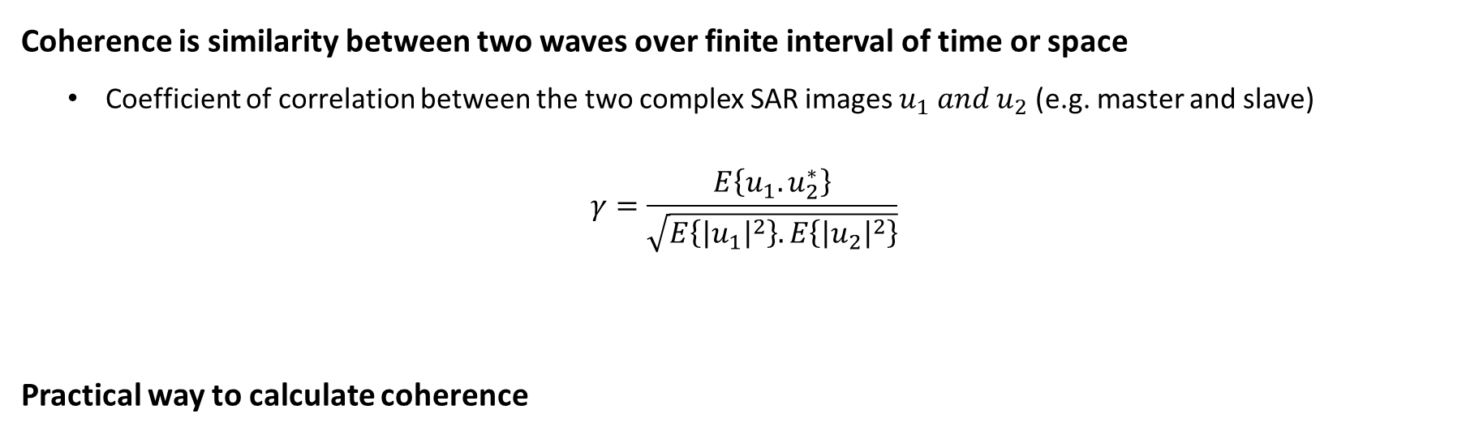
Calculate/Quantify the Coherence
Coherence is similarity between two waves over finite interval of time or space
Coefficient of correlation between the two complex SAR images $u_{1} and u_{2}$ (e.g. master and slave)
$$γ=\frac{E\left\{u_{1}.u_{2}^{∗}\right\}}{\sqrt{E\left\{{\left|u_{1}\right|}^{2}\right\}.E\left\{{\left|u_{2}\right|}^{2}\right\}}}$$
Practical way to calculate coherence
$$\left|\hat{γ}[i,j]\right|=\frac{\left|\sum_{W}{u_{1}\left[i,j\right].u_{2}^{∗}[i,j]}\right|}{\sqrt{\sum_{W}{{\left|u_{1}[i,j]\right|}^{2}}.\sum_{W}{{\left|u_{2}[i,j]\right|}^{2}}}}$$
$$W:small window centered around pixel [i,j]$$

Slide 19
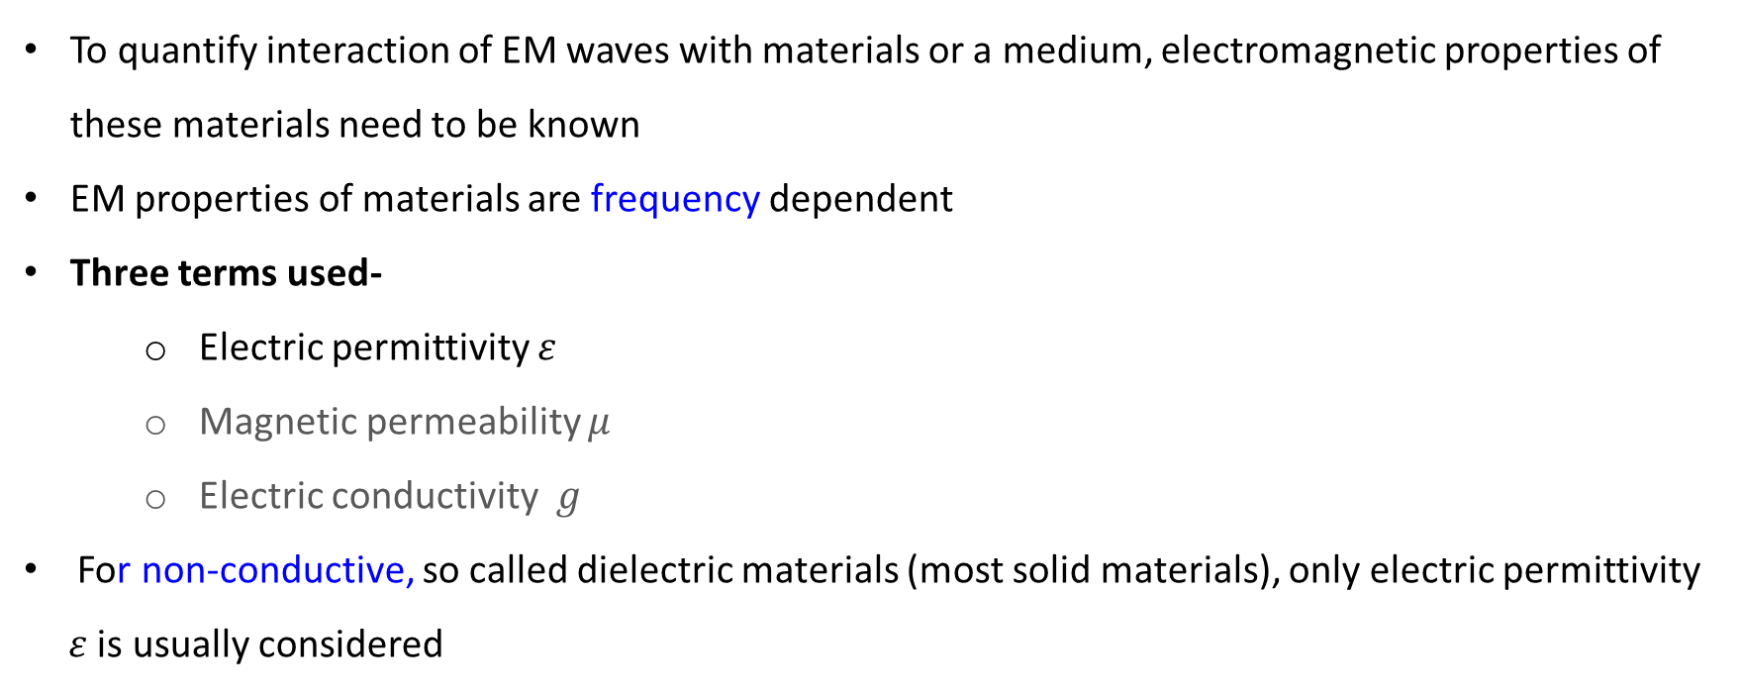
Propagation through Media other than Vacuum
To quantify interaction of EM waves with materials or a medium, electromagnetic properties of these materials need to be known
EM properties of materials are frequency dependent
Three terms used-
Electric permittivity $ε$
Magnetic permeability $μ$
Electric conductivity $g$
For non-conductive, so called dielectric materials (most solid materials), only electric permittivity $ε$ is usually considered

Slide 20
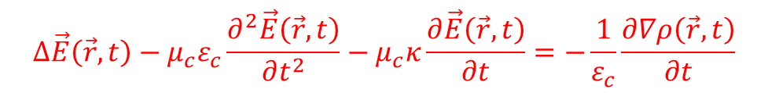
Maxwell’s Equation for Electromagnetism
Maxwell’s equations form the theoretical basis of all electromagnetic waves that propagate through space at the speed of light.
Hertz confirmed Maxwell’s prediction when he generated and detected electromagnetic waves in 1887.
Time-space behavior of EM waves is ruled by Maxwell’s equations
Maxwell Equations Point or Differential Form Integral form
$$Gauss^{′}s Law in Electric Field ∇.D=ρ_{v} \oint{D.dS=Q_{enc}}$$
$$Gauss^{′}s Law in Magnetic Field ∇.B=0 \oint{B.dS=}0$$
$$Faraday^{′}s Law of Induction ∇×E=−\frac{∂B}{∂t} \oint{E.dL=}\frac{∂}{∂t}\int{B.dS}$$
$$Ampere^{′}s Circuital Law ∇×H=J_{c}+\frac{∂D}{∂t} \oint{H.dL=}\int{J_{c}.dS+\frac{∂}{∂t}\int{D.dS}}$$
$$D=εE; B=μH; J=σE$$
$$Δ\vec{E}\left(\vec{r},t\right)−μ_{c}ε_{c}\frac{∂^{2}\vec{E}\left(\vec{r},t\right)}{∂t^{2}}−μ_{c}κ\frac{∂\vec{E}\left(\vec{r},t\right)}{∂t}=−\frac{1}{ε_{c}}\frac{∂∇ρ\left(\vec{r},t\right)}{∂t}$$
EM wave equation

Slide 21
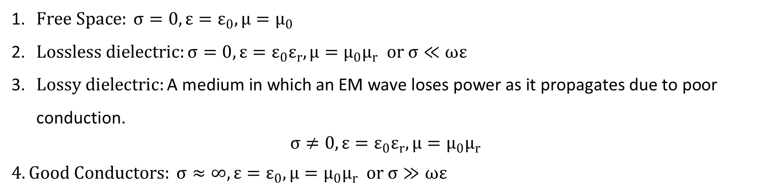
Propagation of EM Waves
Solution of Maxwell’s equations, describes the propagation of EM waves
$Free Space: σ=0, ε=ε_{0}, μ=μ_{0}$
$Lossless dielectric:σ=0, ε=ε_{0}ε_{r}, μ=μ_{0}μ_{r} or σ≪ωε$
$Lossy dielectric:\text{A} \text{medium} \text{in} \text{which} \text{an} \text{EM} \text{wave} \text{loses} \text{power} \text{as} \text{it} \text{propagates} \text{due} \text{to} \text{poor} \text{conduction}\text{.}$
$$σ≠0, ε=ε_{0}ε_{r}, μ=μ_{0}μ_{r}$$
$4.Good Conductors: σ≈∞, ε=ε_{0}, μ=μ_{0}μ_{r} or σ≫ωε$

Slide 22

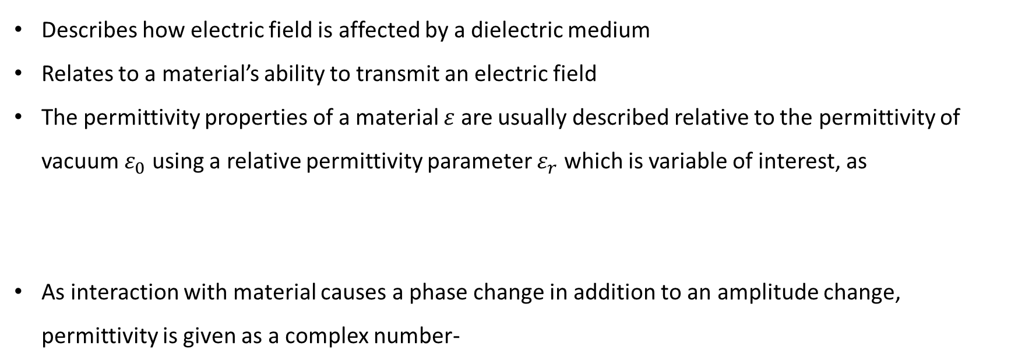

Electric Permittivity
Most important material parameter for Remote Sensing
Describes how electric field is affected by a dielectric medium
Relates to a material’s ability to transmit an electric field
The permittivity properties of a material $ε$ are usually described relative to the permittivity of vacuum $ε_{0}$ using a relative permittivity parameter $ε_{r}$ which is variable of interest, as
As interaction with material causes a phase change in addition to an amplitude change, permittivity is given as a complex number-
$$ε_{r}=\frac{ε}{ε_{0}}$$
$$ε_{r}=ε_{r}^{′}−jε_{r}^{′′}$$
Electric permittivity is often referred to as complex dielectric constant
$ε_{r}$ can vary dramatically for different materials

Slide 23

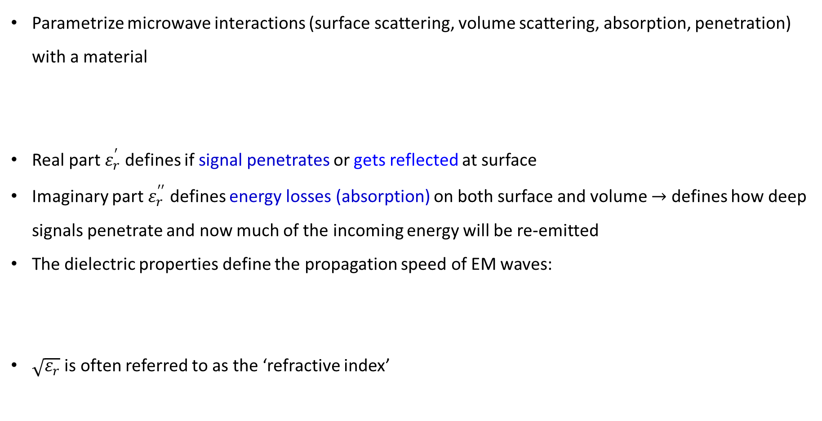

Meaning of the Dielectric Constant
Parametrize microwave interactions (surface scattering, volume scattering, absorption, penetration) with a material
Real part $ε_{r}^{′}$ defines if signal penetrates or gets reflected at surface
Imaginary part $ε_{r}^{′′}$ defines energy losses (absorption) on both surface and volume $→$ defines how deep signals penetrate and now much of the incoming energy will be re-emitted
The dielectric properties define the propagation speed of EM waves:
$\sqrt{ε_{r}}$ is often referred to as the ‘refractive index’
$$ε_{r}=ε_{r}^{′}−jε_{r}^{′′}$$
Real part
Imaginary part
$$v=\frac{1}{\sqrt{ε_{r}}} \frac{1}{\sqrt{μ_{0}ε_{0}}}=\frac{c}{\sqrt{ε_{r}}}$$

Slide 24

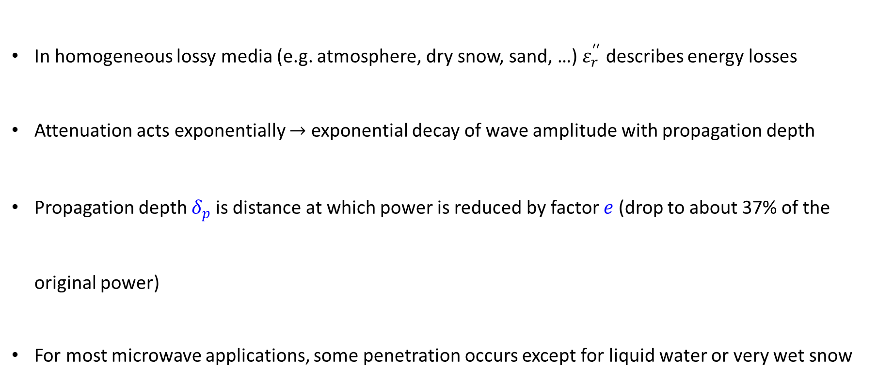
Dielectric Properties Describe Signal Attenuation in Lossy Media
In homogeneous lossy media (e.g. atmosphere, dry snow, sand, …) $ε_{r}^{′′}$ describes energy losses
Attenuation acts exponentially $→$ exponential decay of wave amplitude with propagation depth
Propagation depth $δ_{p}$ is distance at which power is reduced by factor $e$ (drop to about 37% of the original power)
For most microwave applications, some penetration occurs except for liquid water or very wet snow
$$δ_{p}≈\frac{λ \sqrt{ε_{r}^{′}}}{2πε_{r}^{′′}}$$

Slide 25
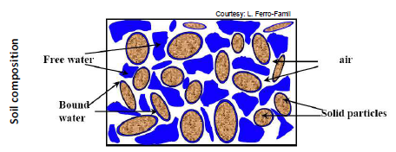

Dielectric Properties and Surface Moisture Content
Dielectric properties of soil is a function of the soil composition of solid particles, soil moisture (free and bound water), and air pockets
Water content of soil is important parameter in defining $ε_{r}$

Slide 26
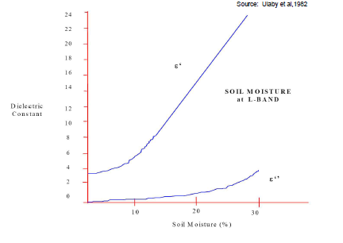
Dielectric Properties and Surface Moisture Content
Dielectric constant proportional to soil moisture
High moisture
- high dielectric constant
- low penetration (surface scattering)
Dielectric Constant
Soil Moisture (%)

Slide 27
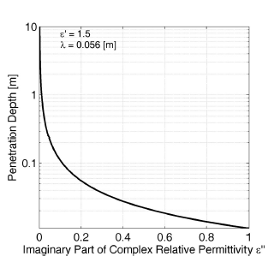
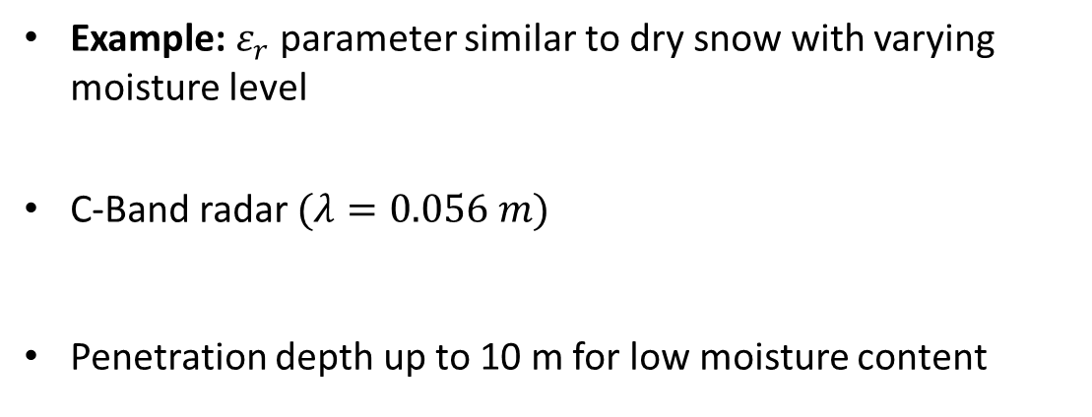
Penetration Depth as a Function of $ε_{r}$
Example: $ε_{r}$ parameter similar to dry snow with varying moisture level
C-Band radar $(λ=0.056 m)$
Penetration depth up to 10 m for low moisture content

Slide 28
Interaction of EMR with Media
Out of 100 units of shortwave radiation:
3 units are absorbed in stratosphere by Ozone layer
25 units are reflected from clouds
19 units absorbed by dust and gases in the lower atmosphere
8 units are reflected from the ground surface
45 units are ultimately absorbed at the Earth’s surface
sensor
signal source
Scattering
Reflection
Incident
object
Absorption
(Thermal)
Emission
Transmission

Slide 29
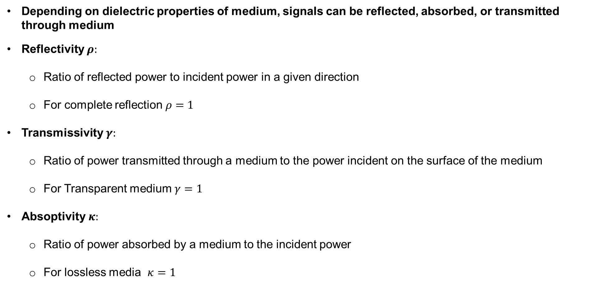
Interaction of EMR with Media
Depending on dielectric properties of medium, signals can be reflected, absorbed, or transmitted through medium
Reflectivity $ρ:$
Ratio of reflected power to incident power in a given direction
For complete reflection $ρ=1$
Transmissivity $γ:$
Ratio of power transmitted through a medium to the power incident on the surface of the medium
For Transparent medium $γ=1$
Absoptivity $κ:$
Ratio of power absorbed by a medium to the incident power
For lossless media $κ=1$

Slide 30
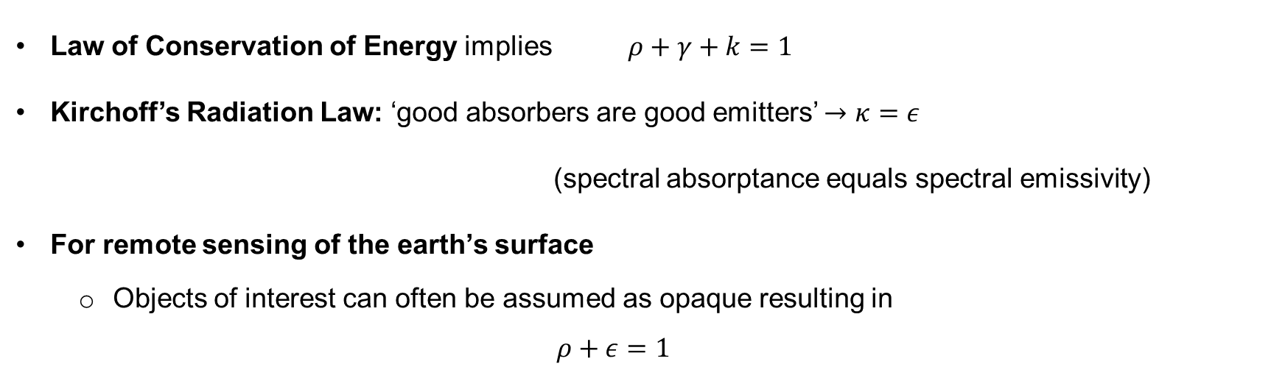
More rules about Interactions with Media and
what they mean for Remote Sensing
Law of Conservation of Energy implies $ρ+γ+k=1$
Kirchoff’s Radiation Law: ‘good absorbers are good emitters’ $→κ=ε$
(spectral absorptance equals spectral emissivity)
For remote sensing of the earth’s surface
Objects of interest can often be assumed as opaque resulting in
$$ρ+ε=1$$
Important Consequence
This brings passive and active microwave remote sensing together as we can derive surface emissivity (passive sensing) from measurements of reflectivity (active sensing) and vice versa

Slide 31
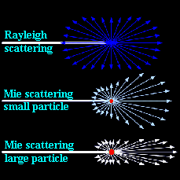
Interaction of EMR with Atmosphere
As solar energy passes through the Earth’s atmosphere, it is subject to modification by several physical processes, including
Scattering
absorption
Refraction
Diffraction
SCATTERING is the redirection of electromagnetic energy by particles suspended in the atmosphere or by large molecules of atmospheric gases. The amount of scattering that occurs depends on:
the sizes of these particles
their abundance
the wavelength of the radiation and
the depth of the atmosphere through which the energy is traveling.

Slide 32
Types of Scattering in Atmosphere
ELASTIC SCATTERING in which the energy of radiation is not changed due to the scattering, and
INELASTIC SCATTERING in which the energy of the scattered radiation is changed.
3 types of ELASTIC SCATTERING is recognized in atmospheric scattering
Rayleigh scattering (λ >> d)
Mie scattering (λ ≈ d)
Nonselective scattering (…)
EFFECTS OF SCATTERING
It causes haze in remotely sensed images
It decreases the spatial detail on the images
It also decreases the contrast of the images

Slide 33
Thank You!

